Slide 1

Human Factors Engineering in Medical Device Design
- Sarthak Raj
Notes:
Human Factors Design Engineering (HFD) is crucial in optimizing human-system interaction and performance in medical device design. It enhances patient safety, clinical workflows, and reduces development costs.

Slide 2

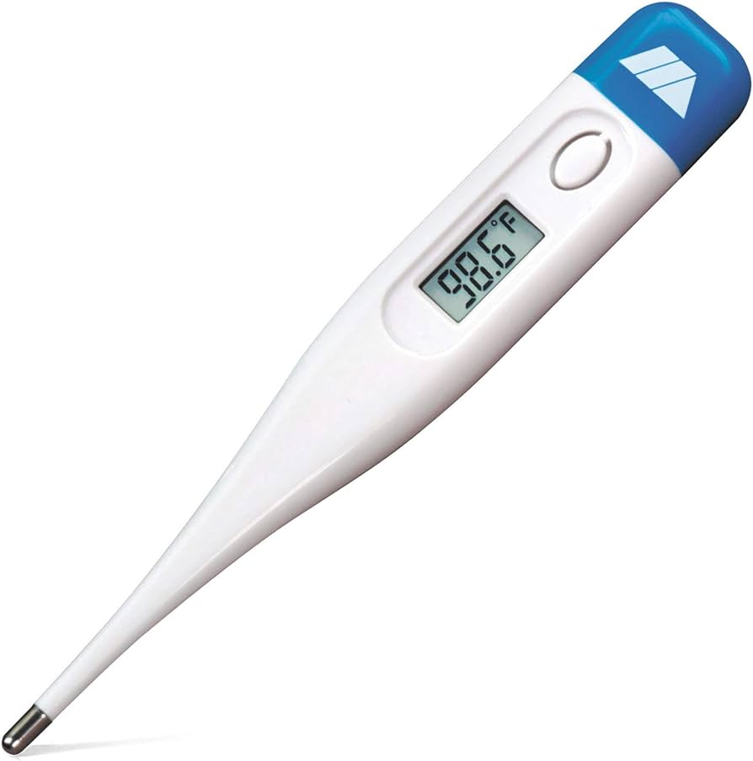
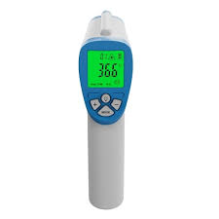

Slide 3
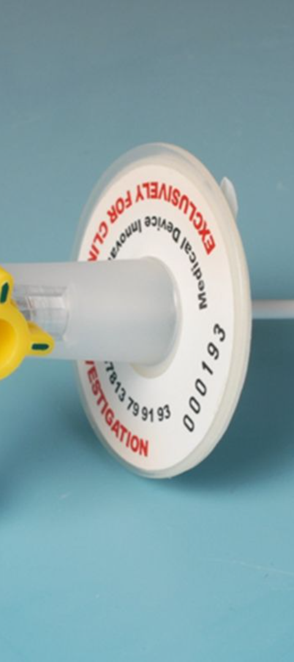

1
Aim
Synthesizing HFD in Medical Devices
2
Objectives
Identify, Discuss, Outline HFD
3
Scope
Integration, Challenges, Opportunities
Notes:
Aim: To Identify and synthesize literature on HFD in medical device design and to provide recommendations for improvement.
Objectives:
To Identify key topics and findings.
To Discuss challenges and opportunities.
And To Outline future directions for HFD.
Scope: Importance, integration, user involvement, methods/tools, successful examples, challenges, and opportunities of the same.

Slide 4




Key Findings
Reduce Patient Harm
Integrated Approach
User Involvement
Notes:
HFD reduces patient harm.
Integration throughout the development process is crucial.
User involvement is essential.
Various methods and tools are available.

Slide 5
Conclusion and Future Directions
Conclusion:
Future Directions:
HFD is essential for safe and effective medical devices.
Increased use of Human-Centred Design (HCD) methods.
Reduces patient harm, improves usability, crucial in emerging technologies.
More reliance on simulation, modelling, and machine learning (ML) for efficient HFD methods and tools.

Slide 6

Thank You

